Slide 1
Introduction to Machine Learning
AINT351 Machine Learning
Semester 1, 2015/16
Ian Howard and Torbjorn Dahl

Slide 2
Matlab – A mathematical language
Good for expressing mathematical concepts
Clear
Efficient
Good for plotting
Already has implementations of many ML algorithms
C4.5
Deep neural networks
Can be fast
Matrix operations
GPU support (Parallel Computing Toolbox)

Slide 3
Planned Topics
Ambitious and likely to change
Week | Torbjorn | Practical (indicative)
1 | MATLAB
2 | Classification | P2.1
3 | Confidence and Cross-validation
4 | Model-free learning and Q(λ)
5 | MDPs and Dynamic Programming
6 | Models, Planning and Dyna-Q | P2.2
7 | Neural Networks and Q-functions
8 | POMDPs, Belief State and Witness
9 | Point-Based methods and SARSOP
10 | Instance-based methods and NSM | P2.3
11 | Explicit Temporal Encoding in ANNs
12 | Review

Slide 4
MATLAB Bootcamp
Unit tests
Programming
Run tests
Demo

Slide 5
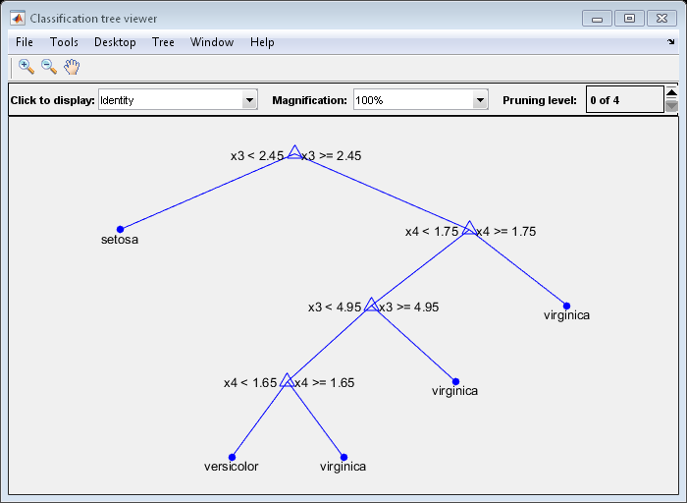
What is a decisions tree?
A set of ordered rules for classifying data
Each node addresses an input variable
Leaves assign labels to the data

Slide 6
Types of Decision Trees
Classification trees have leaves with discrete classes
Regression trees have leaves with numerical values

Slide 7
Advantages of Decision Trees
Simple and intuitive
Good computational performance

Slide 8
Limitations of Decision Trees
Greedy algorithms can get stuck in local optimality
The simple decision structure does not represent all problems effectively
XOR, parity
Produce large trees
Can produce overly complex trees that do not generalise well
overfitting

Slide 9
Decision Tree Learning Algorithms
Information gain
ID3
C4.5
Gini Impurity and Variance Reduction
CART
MARS
CHAID
Conditional Inference Trees

Slide 10
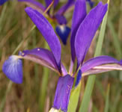
Fisher’s Iris Data Set
From the UCI ML repository
Measurements of plant parts
Four real valued attributes
sepal length in cm, sepal width, petal length, petal width
Classified into three types of iris plants
Setosa, Versicolor and Virginica

Slide 11
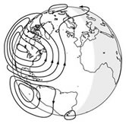
Ionosphere Data Set
From the UCI ML repository
Radar data from the ionosphere
34 continuous variables
Classified into ‘good’ and ‘bad’ readings
Good readings provide evidence of structure in the ionosphere

Slide 12
How are decision trees constructed
The data set is split recursively into sub-sets based in a single input variable
Until
All sub-set has same class
Splitting no longer improves prediction
Sub-sets are too small
Top-down induction of decision trees (TDIDT)
Greedy

Slide 13
How are the sets split?
Identify Candidate splits
Loop through all possibilities
Apply metric to the resulting sub-sets
Choose the split that produces the best sub-sets

Slide 14

Information Gain
Information gain is the change in entropy
Entropy is based on the probability estimates
For this the algorithms uses frequencies
The expected information gain is the difference in the sum of entropy across the sub sets

Slide 15
Gini Impurity
Uses the square of the probabilities of each class
The Gini impurity reflects the sum of the probability of each target class (squared) within a sub-set
The improvement the weighted sum of the Gini impurities

Slide 16
Variance Reduction
For regression trees
Calculate the variance of the node before the split
Compare with the sum of the variances in the new nodes

